Slide 1
Data Deep Dive
C.J. Mittica
Nate Kucsma

Slide 2
Industry Sales

Slide 3
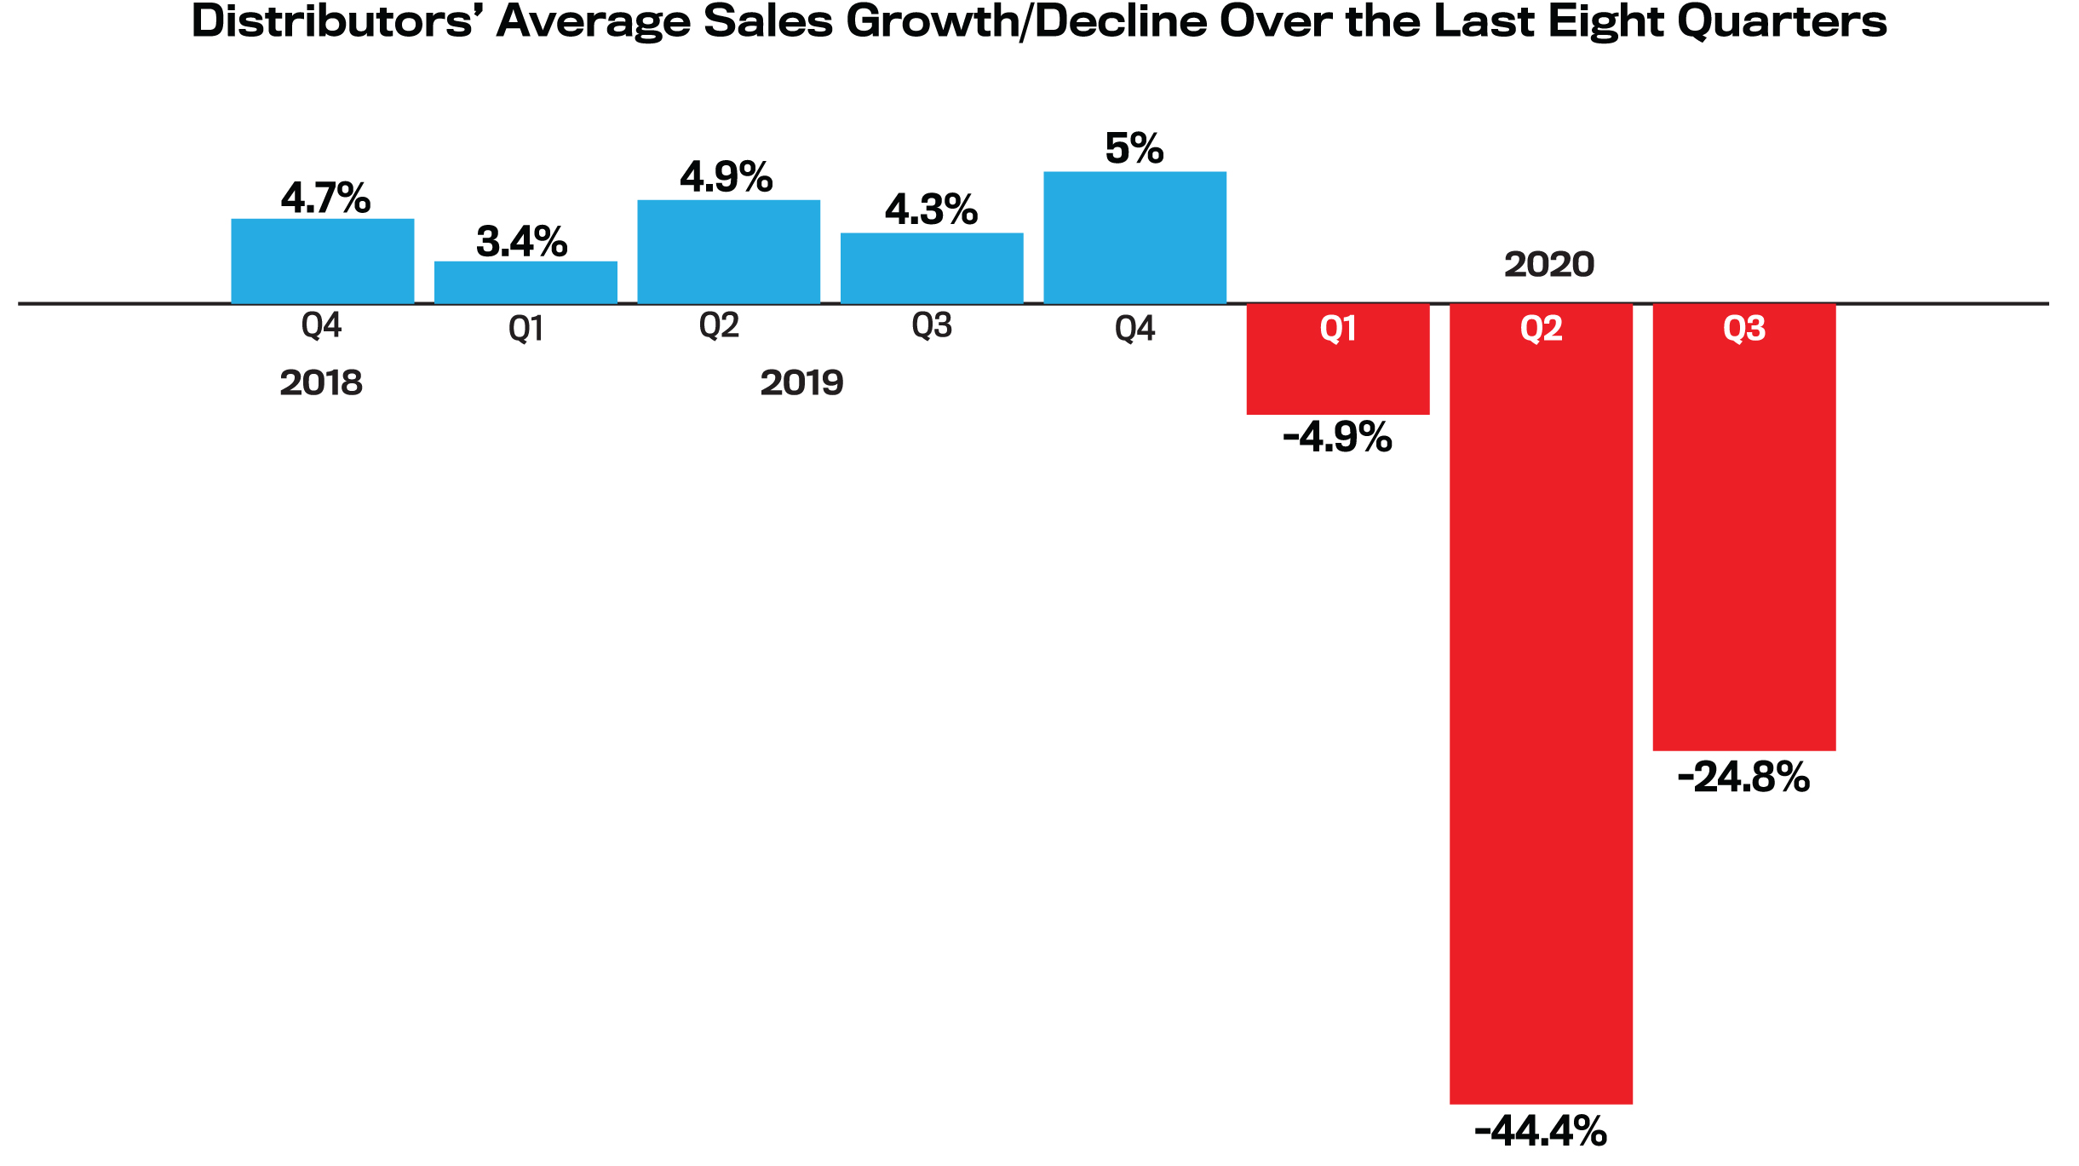

Slide 4
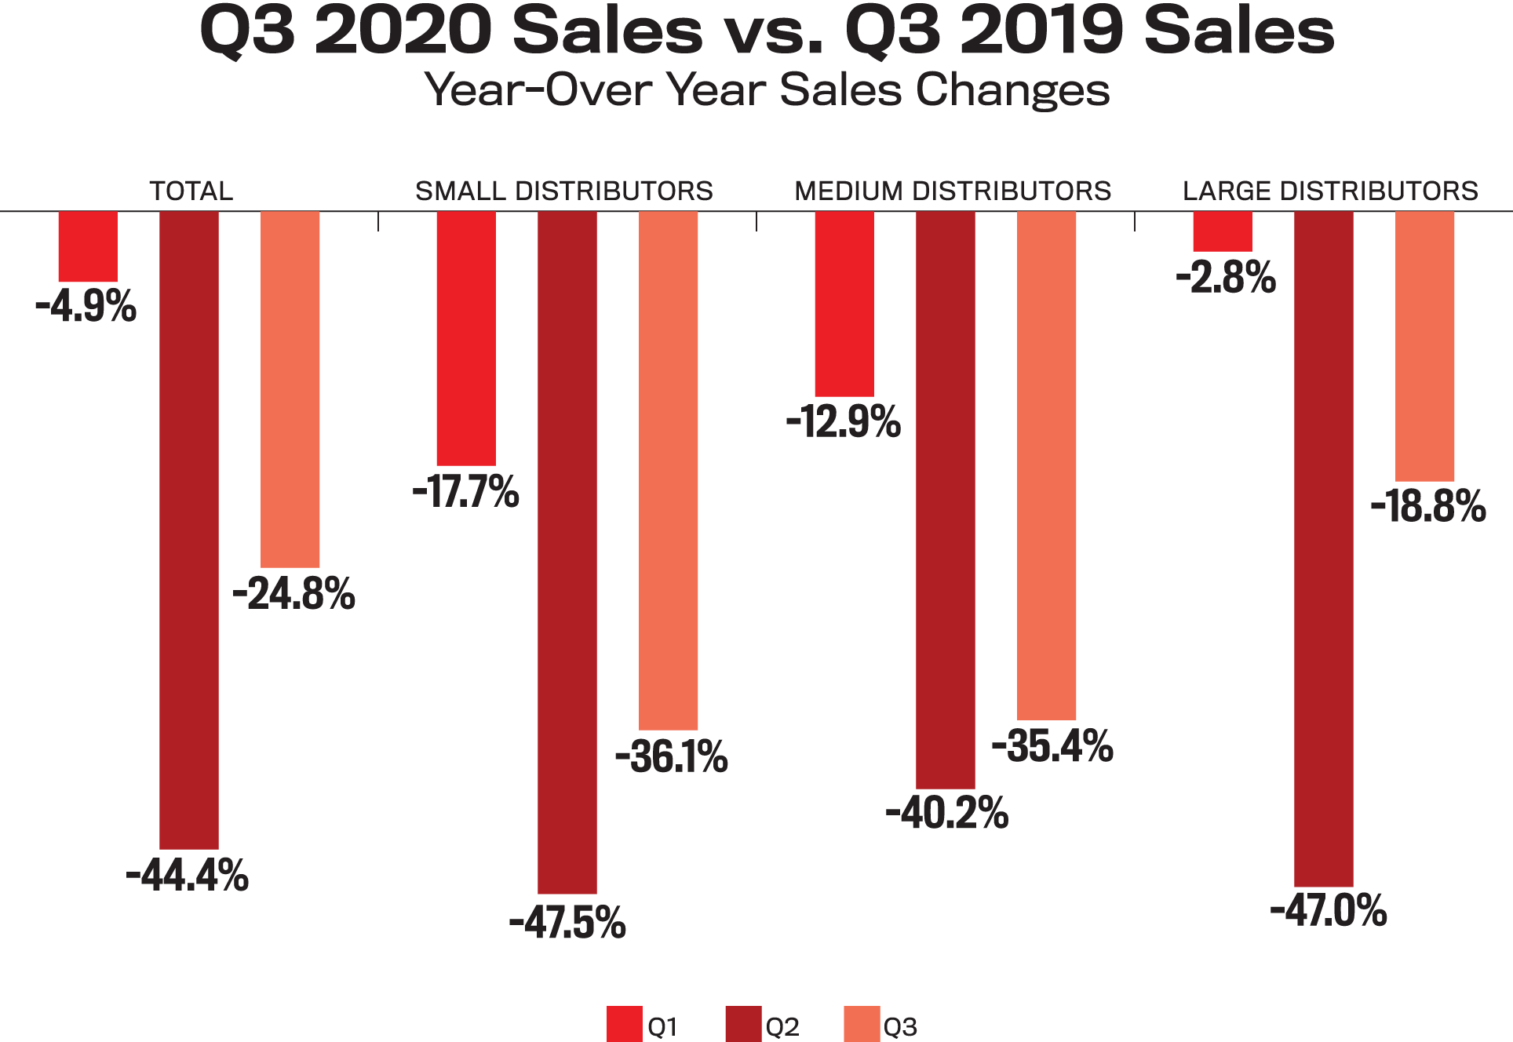

Slide 5
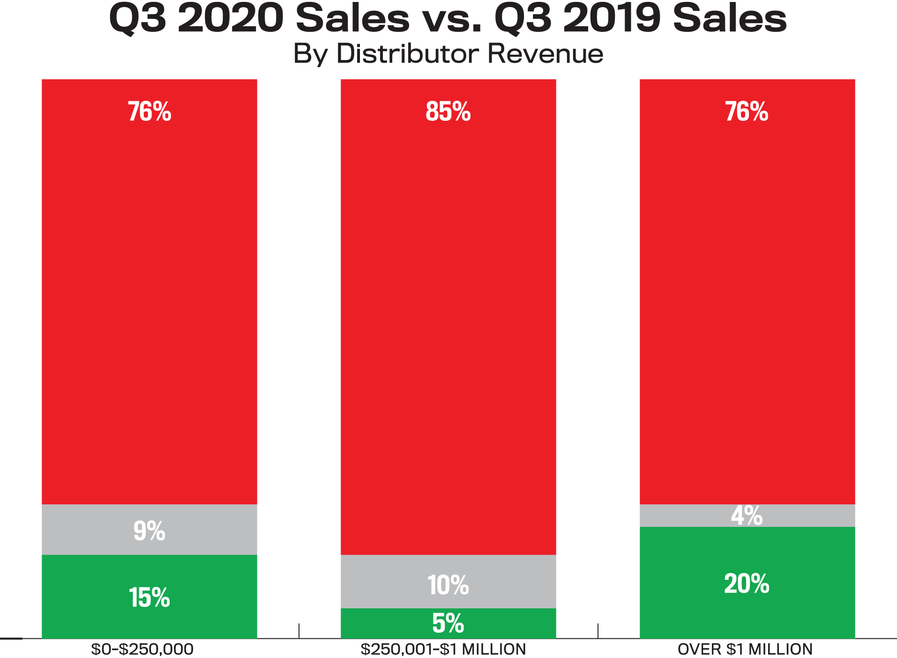
Decrease
Unchanged
Increase

Slide 6
Counselor Confidence Index

Slide 7
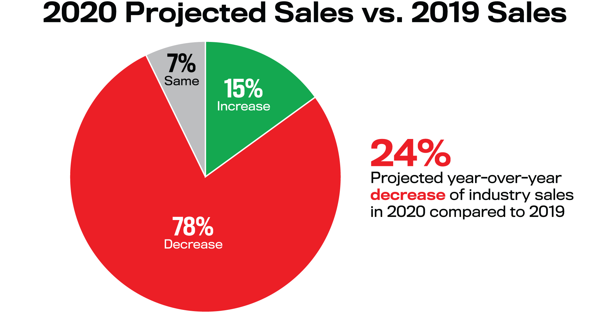

Slide 8
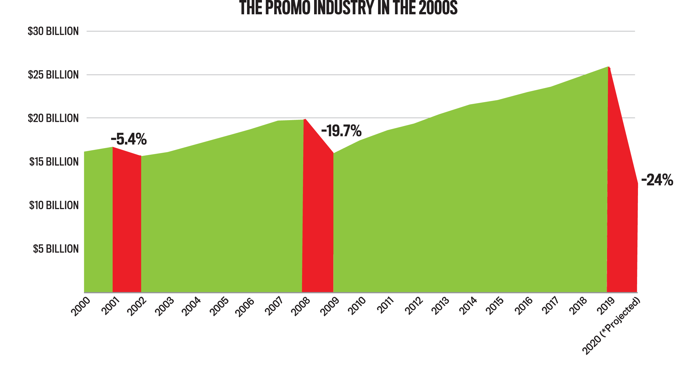

Slide 9
Industry Sales Outlook for 2020 vs. 2019

Slide 10
Ad Impressions
-PPE-

Slide 11
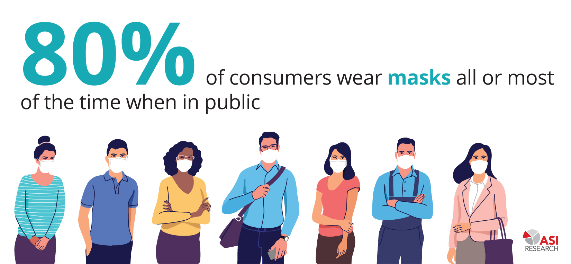

Slide 13
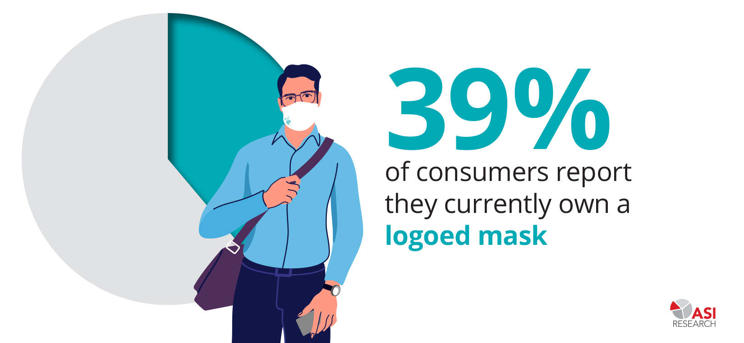

Slide 14
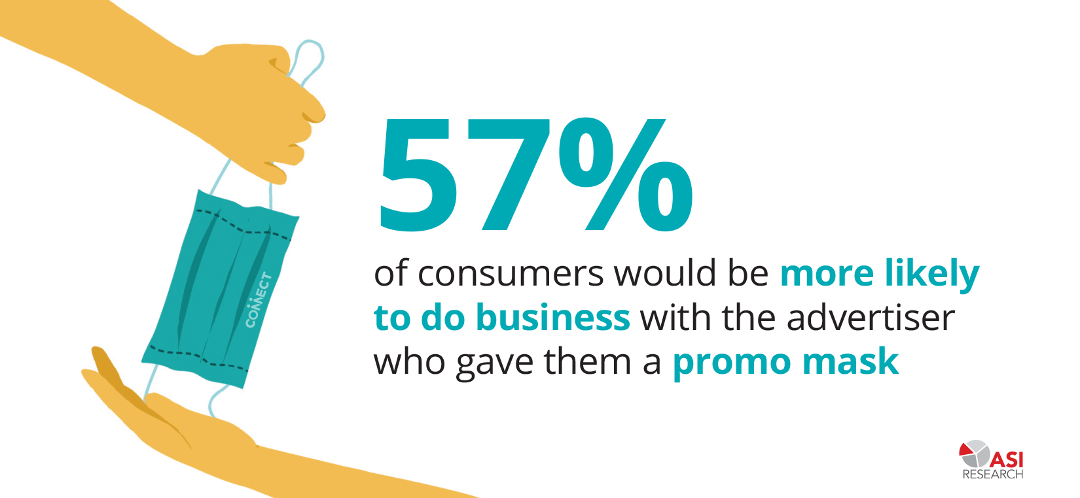

Slide 15
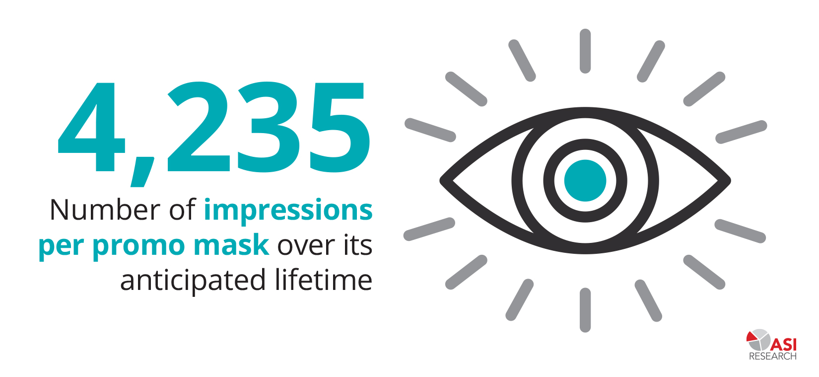

Slide 16
ESP Data

Slide 17
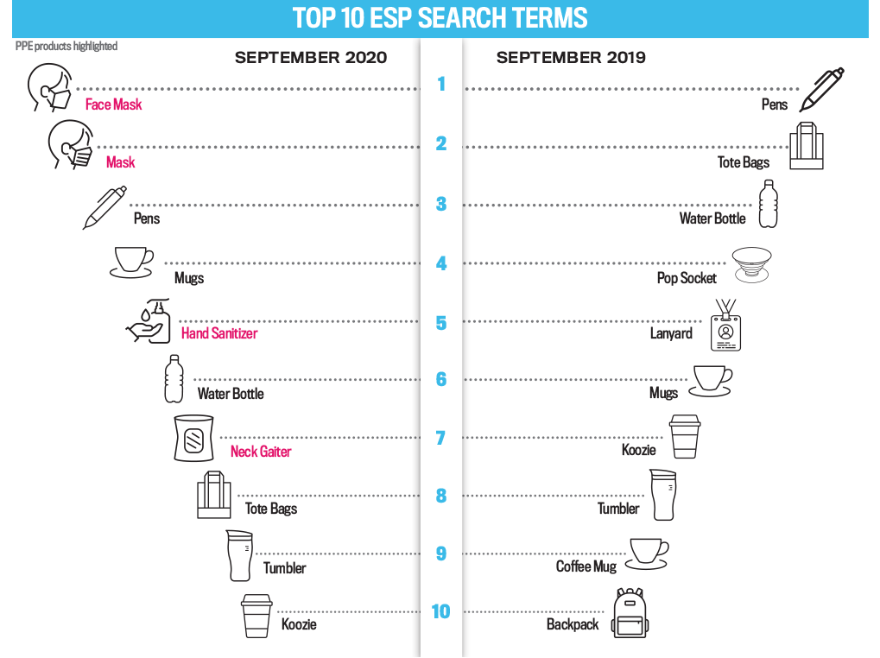

Slide 19
Political Polling

Slide 20
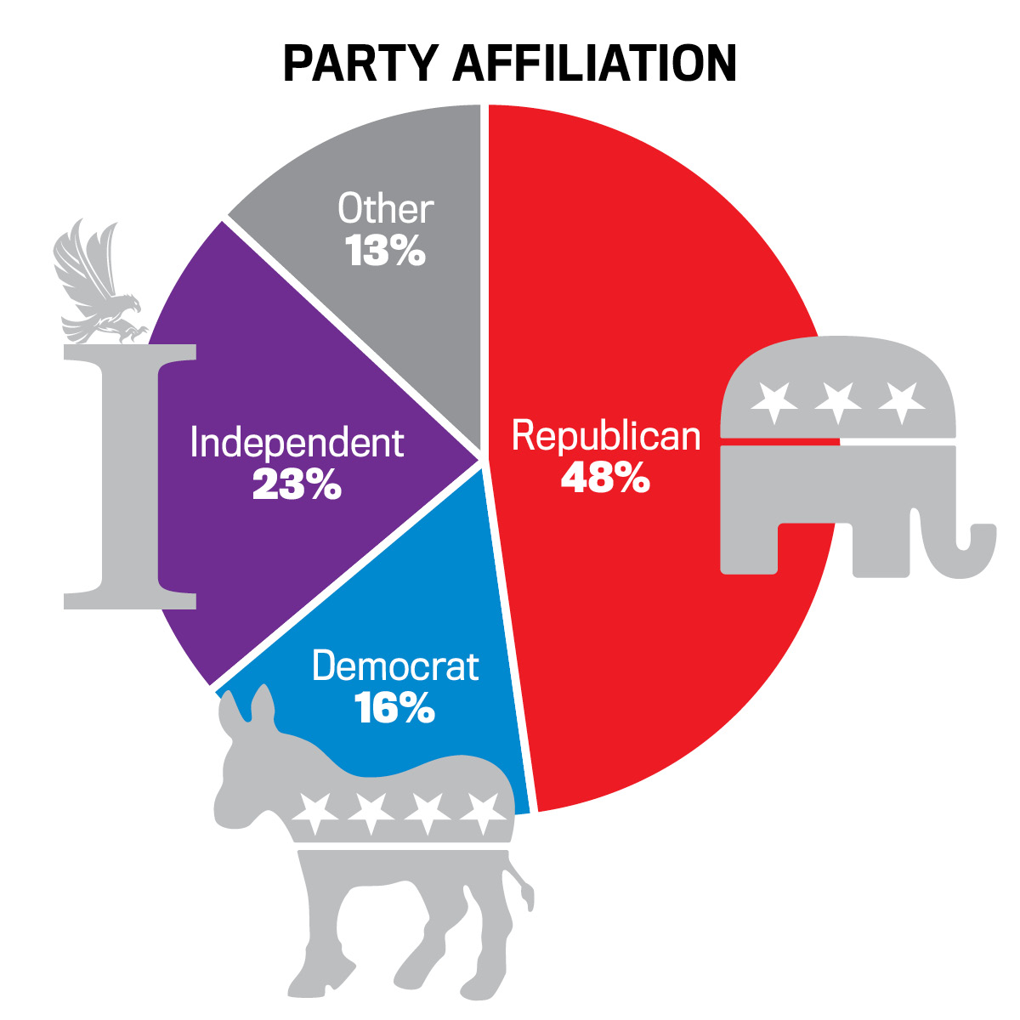

Slide 21
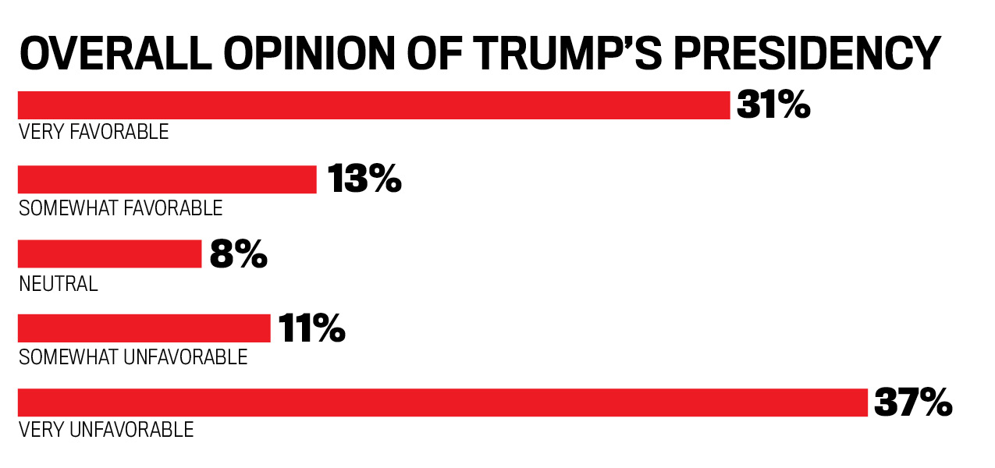

Slide 23
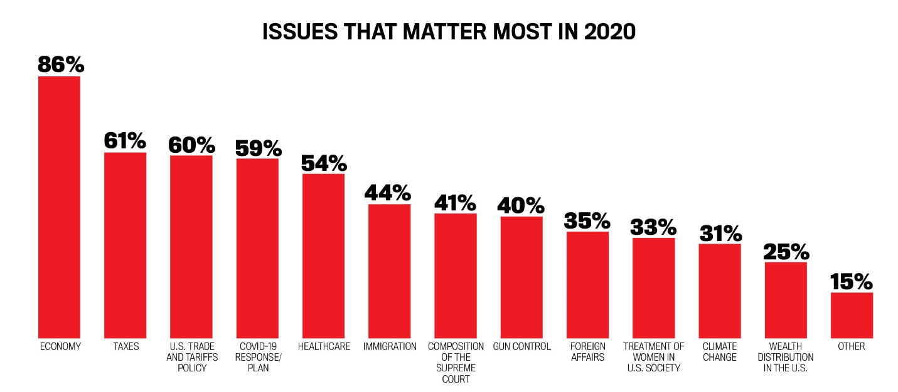

Slide 24
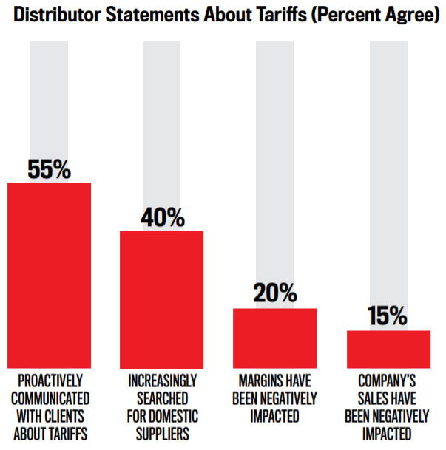

Slide 25
CMittica@asicentral.com
@CJ_ASIEditor
www.asicentral.com/research
nkucsma@asicentral.com
@Nate_Kucsma_ASI

